Slide 1
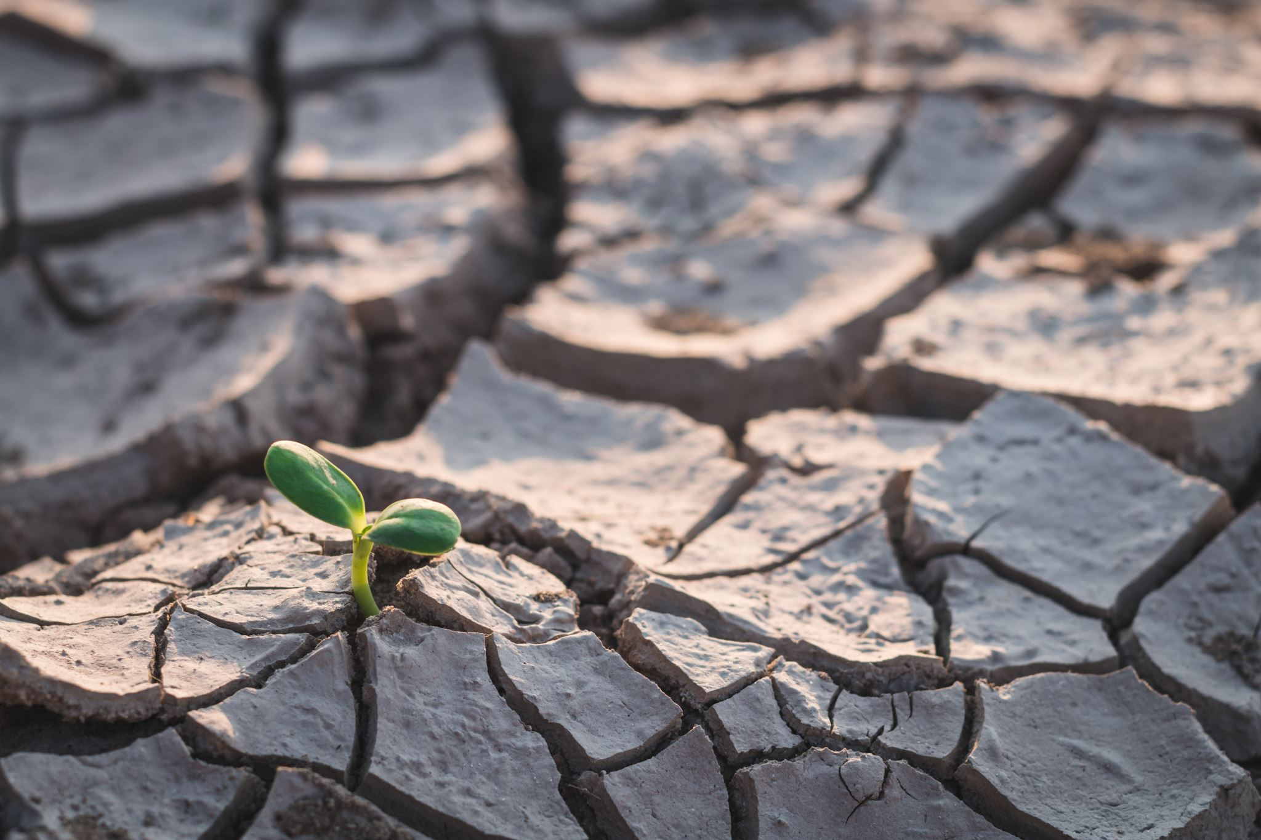
Growing Hope: Supporting Climate Care in Kenya
The Bishop of Chelmsford’s Lent Appeal

Slide 2
Dear God, Thank you for the beauty of your creation. For mountains, forests, animals, rivers and all the places where people live and grow. We pray today for our friends in Kenya. Bless the communities of Embu, Kirinyaga, Meru, Mbeere and Marsabitas as they work to care for the environment. Help their projects to grow strong: projects that plant trees, protect wildlife, save water, grow food sustainably and give families new opportunities for the future. As we journey through Lent teach us to make good choices for your world too, to notice the beauty around us, to reduce waste, to be generous and to look after the earth you have given us. May we stand together with our global neighbours, sharing hope, kindness and love. Amen.
Gather

Slide 3
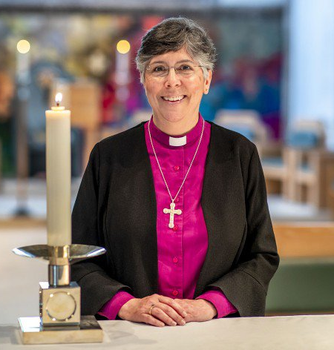
Bishop Guli, the Bishop of Chelmsford, is raising funds for our friends in Kenya to support community work related to the environment. This fundraising will help to support four main areas. Reflect on each area over the next four slides.
Engage

Slide 4
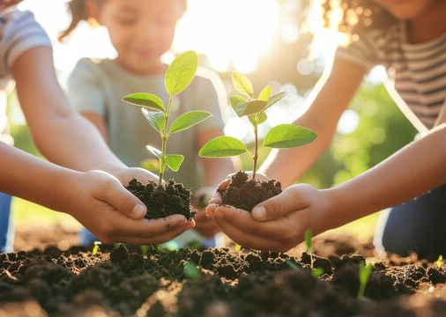
Tree planting
When we plant a tree we are helping God’s creation to breathe and grow.
Engage
Notes:
How does planting trees help the world to breathe?

Slide 5
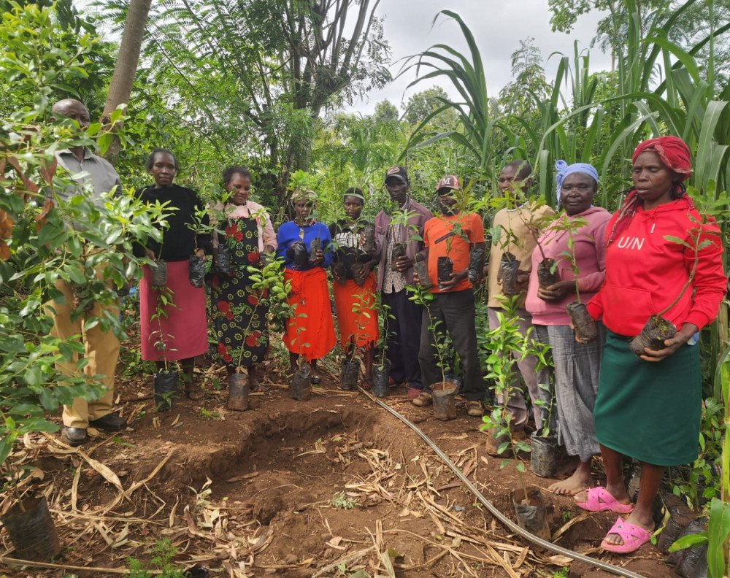
Helping the land heal itself
Even tiny shoots can become strong trees when we protect them.
Engage
Notes:
What is happening in this picture?

Slide 6
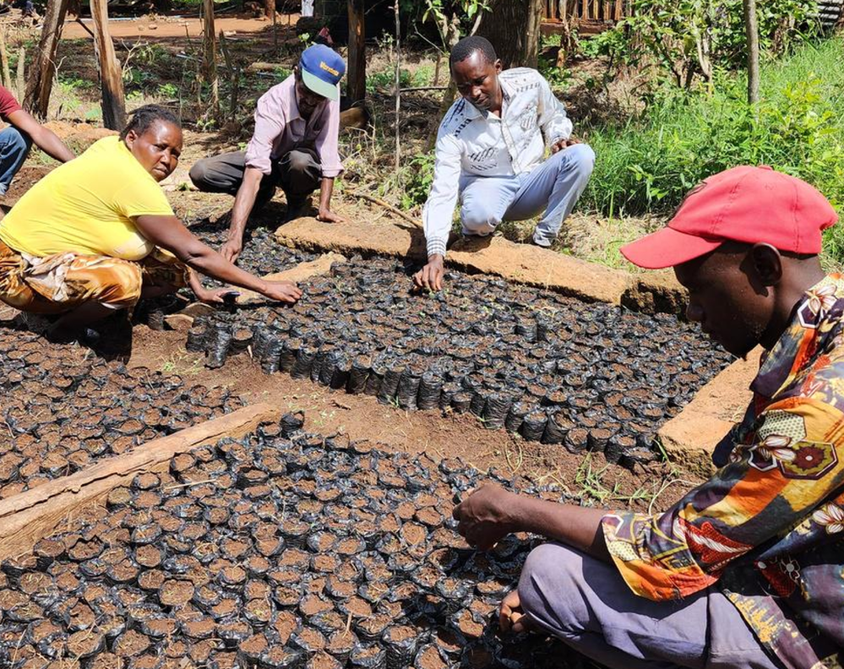
Growing food and trees together
When we care for the land wisely, everything, people, plants, and animals, can flourish together.
Engage
Notes:
Who is flourishing in this image?

Slide 7
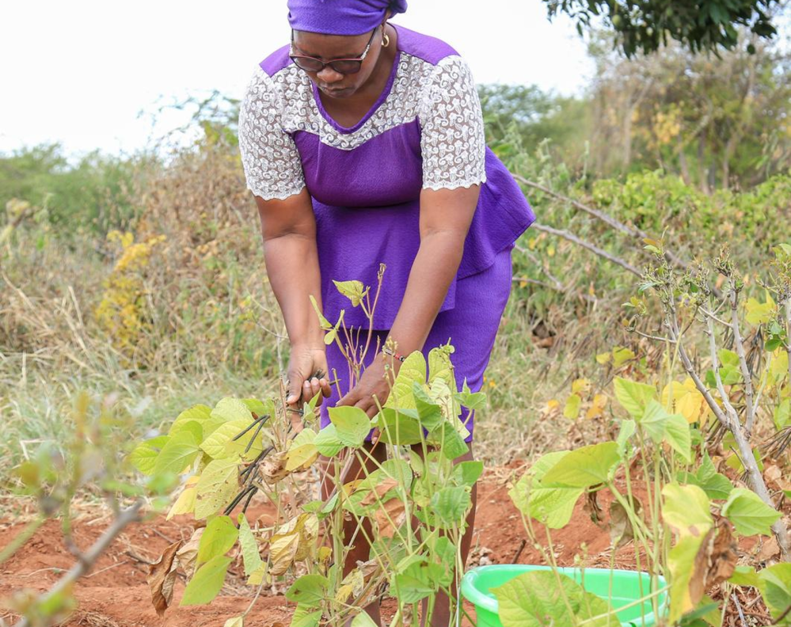
Farming God’s way
We honour God when we look after the world He made.
Engage
Notes:
How is the lady in this image honouring God?

Slide 8
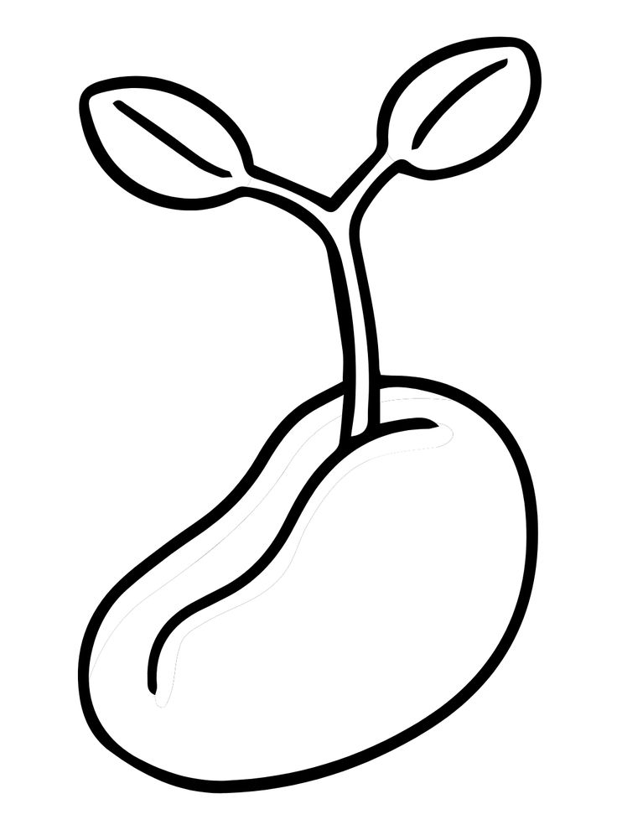
Planting Hope
Just like the communities in Kenya, we can care for God’s world by planting hope through our choices. What small action will you grow this week?
On a seed of hope, write down one action you can take to care for God’s creation.
Commit to this action throughout Lent.
Respond
Notes:
A Seed of Hope display can be created with pupil’s seed commitments.

Slide 9

Dear God, Thank you for the beauty of your world and for our friends in Kenya who are working hard to care for your creation.
We stand together.
Response: To care for God’s creation.
Help us to make good choices every day, to protect nature, to use less, to share more and to look after the places where we live and play.
We stand together.
Response: To care for God’s creation.
Guide us to grow hope, kindness and courage so that our small actions help your world to flourish, near and far.
We stand together.
Response: To care for God’s creation.
Respond
Notes:
Invite pupils to respond ‘To care for God’s creation’ when they here ‘We stand together’ at the end of each prayer verse.

Slide 10

Dear God,
Thank you to all those caring for the world with love.
Guide us to make wise and hopeful choices.
Send us out to shine your light today.
Amen.
Let us hold out both hands with our palms up as a sign of offering hope, kindness and care to God’s world. Let us move our hands to our hearts as we say together, “We go in peace to care for God’s creation.”
Send
Notes:
Invite pupils to join the prayer if they wish or take a moment of silence.

